Slide 1

DEEP FAKE DETECTOR FOR IMAGES
DEPARTMENT OF ELECTRONICS ENGINEERING COLLEGE OF ENGINEERING CHENGANNUR
PRESENTED BY,
Bestin K Benny
Arjun Vasavan
E N Aadhila Nazeer
Hena Maria Biju
Jervin Abraham Kuriakose
GUIDED BY,
Smt. SULAJA SANAL
Assistant Professor
Department of computer science
COORDINATED BY,
Smt. GEETHA S
Assistant Professor
Department of computer science

Slide 2
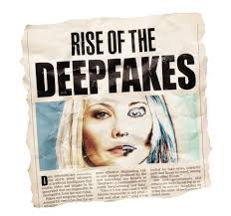
INTRODUCTION
Deepfakes are artificially generated or manipulated media that pose significant threats to privacy, misinformation, and security.
The rise of deepfake technology has made it increasingly challenging to distinguish authentic content from manipulated media, especially in images.
Deep Fake Detection leverages advanced machine learning algorithms to identify subtle inconsistencies and anomalies within media files.
This project focuses on developing an effective solution to detect deepfakes in images, addressing a critical need for maintaining trust in digital content.

Slide 3
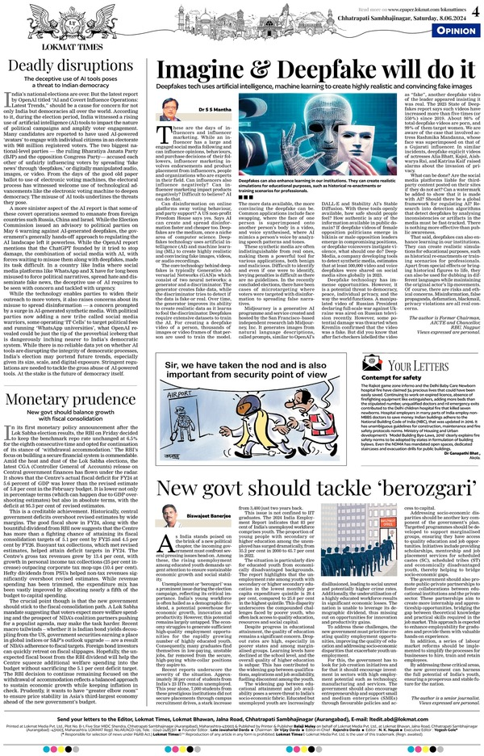
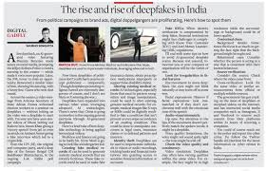
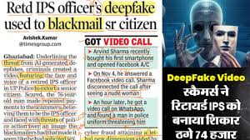
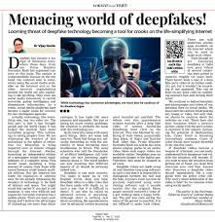
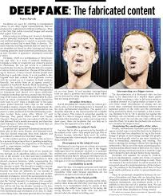
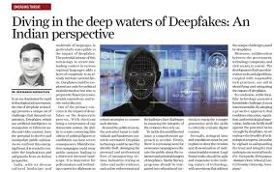

NEWPAPER REPORTS

Slide 4
LITERATURE SURVEY
SI.NO | TITLE | AUTHOR | YEAR | WORK
1 | Deep Fake Detection for Human Face Images and Videos: Survey | Asad Malik, Minoru Kuribayashi, Sani M. Abdullahi, Ahmad Neyaz Khan | 2022 | The paper surveys techniques for detecting deepfake manipulations in face images and videos, highlighting challenges and future directions
2 | Deepfake Detection: A Systematic Literature Review | Md Shohel Rana, Mohammad Nur NOBI, Beddhu Murali, And Andrew H. Sung | 2022 | The paper examines and categorizes existing deepfake detection techniques, evaluates their effectiveness, and identifies limitations and opportunities for future advancements.

Slide 5
SI.NO | TITLE | AUTHOR | YEAR | WORK
3 | An enhanced deep learning-based deepfake video detection and classification system | Joseph Bamidele Awotunde, Rasheed Gbenga Jimoh, Agbotiname Lucky Imoize, Akeem Tayo Abdulrazaq, Chun-Ta Li and Cheng-Chi Lee | 2022 | The paper presents an advanced deep learning system for detecting and classifying deepfake videos, emphasizing improved accuracy and robustness against manipulations.
4 | Deep Learning Applications for Cybersecurity and Forensics | Mohit Sewak, Neeraj Suri, Rudra Pratap Dubey | 2021 | The book explores various deep learning techniques, focusing on convolutional neural networks (CNNs) for tasks like image classification and anomaly detection.

Slide 6
OBJECTIVES
Identify and classify manipulated media (images) as authentic or fake.
Detect and mitigate the misuse of AI-generated content to prevent misinformation.
Enhance public trust in digital media by combating deepfake threats.

Slide 7
HARDWARE REQUIREMENTS
CPU: A multi-core processor, preferably Intel i5/i7 or AMD Ryzen 5/7, for efficient data processing and model execution.
GPU: A dedicated GPU with CUDA support, such as NVIDIA GTX 1660 or higher, for accelerating deep learning tasks.
RAM: Minimum 16 GB to handle large datasets and model training/inference efficiently.
Storage: At least 500 GB SSD for faster data access and sufficient space for datasets, model files, and logs.
Network Interface: High-speed Ethernet or Wi-Fi adapter for downloading datasets and communicating with APIs or cloud services.

Slide 8
SOFTWARE AND TOOLS REQUIREMENTS
Google Colab: A cloud-based platform for training and testing machine learning models, offering free GPU/TPU access.
TensorFlow: A powerful deep learning framework for building and training the convolutional neural network (CNN) model.
FastAPI: A high-performance web framework for creating and deploying the backend API for the deepfake detection system.
ReactJS: A frontend library for building an interactive and user-friendly interface to display detection results.
VSCode (Visual Studio Code): An integrated development environment (IDE) for writing, debugging, and managing the project’s codebase.

Slide 9
QUALITY REQUIREMENTS
Accuracy and Reliability: Achieve high precision in detecting and classifying manipulated media while ensuring consistent performance across various input types.
Robustness and Security: Ensure resilience against adversarial attacks and maintain secure handling of sensitive media.
User-Friendly Design: Provide an intuitive interface and seamless integration for ease of use by technical and non-technical users.

Slide 10
METHODOLOGY
Model Training:
Use publicly available datasets (e.g., Kaggle or Celeb-DF) containing genuine and deepfake images. Preprocess images by resizing them and applying augmentation techniques (flipping, rotation, noise).
Train a Convolutional Neural Network (CNN) for feature extraction, with ReLU activation for intermediate layers and softmax for multi-class classification.
TensorFlow Serving:
Export the trained model in TensorFlow's SavedModel format.
Use TensorFlow Serving to deploy the model for efficient, scalable inference requests, processing image inputs for deepfake detection.

Slide 11
Backend with FastAPI:
Implement a FastAPI backend to expose the model via REST API. It will handle image uploads, interact with TensorFlow Serving for inference, and return results to the frontend.
Frontend with ReactJS:
Develop a responsive ReactJS interface for users to upload media files. Upon receiving a file, the UI sends it to FastAPI, which processes the image and displays the detection result ("authentic" or "deepfake") on the frontend.
Deployment:
Package the system using Docker for easy deployment. Optionally, use Kubernetes for scalability in a production environment, ensuring efficient handling of multiple requests.

Slide 12
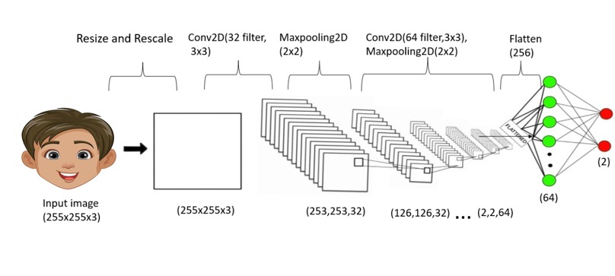
ARCHITECTURE OF DEEP FAKE DETECTOR

Slide 13
Input Image (255x255x3)
The input is an RGB image with dimensions 255x255 and 3 color channels (Red, Green, Blue).
Resize and Rescale
The image is resized to a fixed size (255x255) and pixel values are normalized (scaled to a range of 0 to 1) for easier processing.
First Convolutional Layer (Conv2D)
A 2D convolutional layer with 32 filters and a 3x3 kernel extracts basic features such as edges and textures from the image.
The output shape becomes 253x253x32 (valid padding).

Slide 14
First MaxPooling Layer (MaxPooling2D)
A pooling operation with a 2x2 window downsamples the feature maps by retaining the maximum value in each 2x2 region.
The spatial dimensions reduce to 126x126x32, while the number of filters remains 32.
Second Convolutional Layer (Conv2D)
A second convolutional layer with 64 filters and a 3x3 kernel extracts more complex patterns.
The output shape becomes 126x126x64.
Second MaxPooling Layer (MaxPooling2D)
Another max-pooling layer (2x2) further downsamples the feature maps, reducing the output size to 2x2x64.

Slide 15
Flatten
The 3D feature maps (2x2x64) are flattened into a single 1D vector of size 256 (2 × 2 × 64) for compatibility with dense layers.
Fully Connected Layer (Dense)
The flattened vector is passed through a dense layer that connects to all neurons, learning high-level patterns for classification.
Output Layer
The final layer outputs a prediction for two classes (e.g., Fake vs. Real) using an activation function like softmax or sigmoid.

Slide 16
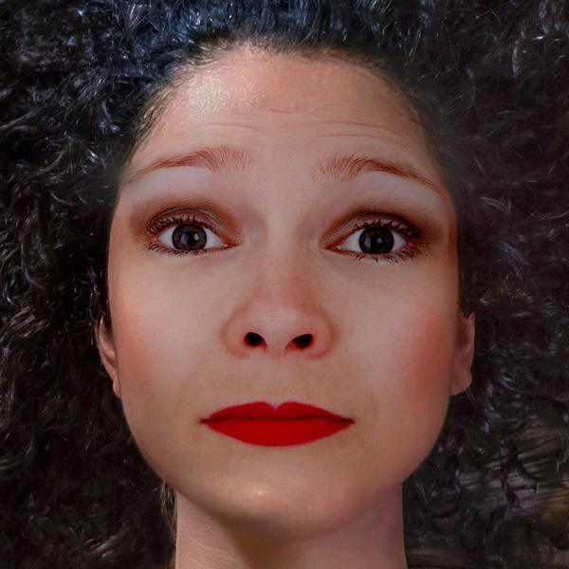
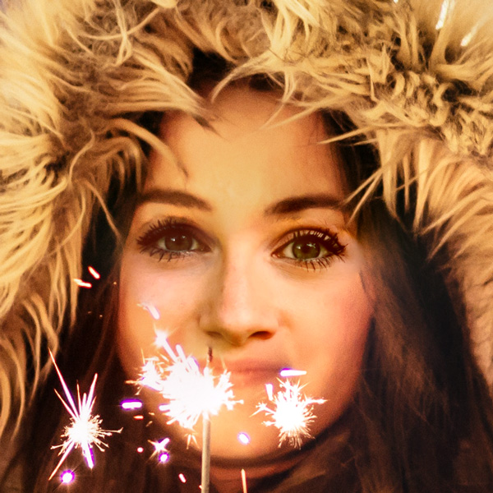


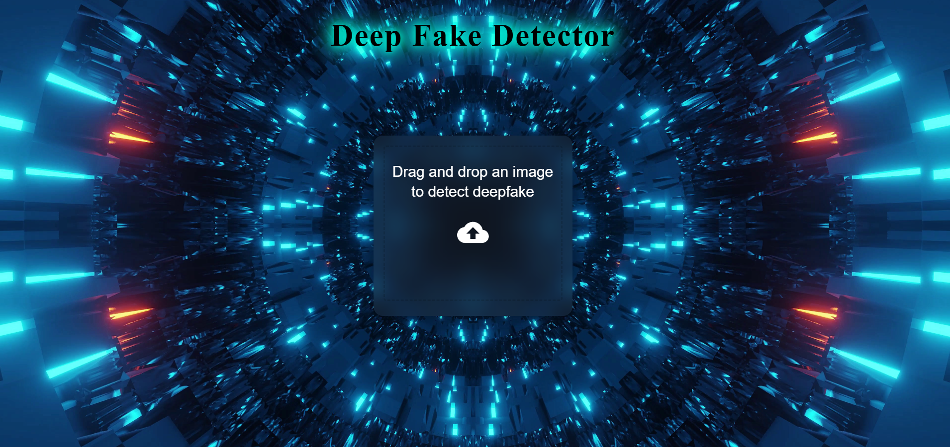

WORK FLOW OF DEEP FAKE DETECTOR
Preprocessing
Model Building
Tensorflow serving
Tensorflow dataset
CNN
http://localhost:8501
Data augmentation
http://localhost:8000

Slide 17
WORKING
Preprocessing:
Input: Raw images (real and deepfake) are collected from datasets.
Process:
TensorFlow Datasets: Publicly available datasets are used to provide a mix of genuine and manipulated images.
Data Augmentation: Techniques like flipping, rotation, and noise addition are applied to enhance the dataset and improve the model's robustness.
Output: Preprocessed and augmented data is prepared for training the model.
Model Building:
Input: Preprocessed dataset.
Process:
A Convolutional Neural Network (CNN) is designed and trained to extract spatial features and classify media as "authentic" or "deepfake."
The model learns patterns and anomalies characteristic of deepfake media.
Output: A trained CNN model capable of performing deepfake detection.

Slide 18
TensorFlow Serving:
Purpose: The trained CNN model is exported in TensorFlow's SavedModel format and deployed using TensorFlow Serving.
Process:
TensorFlow Serving hosts the model on a server and exposes an API endpoint (http://localhost:8501) for making inference requests.
This allows the model to process input data and return predictions in real-time.
FastAPI (Backend):
Purpose: FastAPI acts as a middleware to facilitate communication between the user interface and TensorFlow Serving.
Process:
FastAPI accepts media inputs (e.g., images) from the UI via http://localhost:8000.
It forwards the data to TensorFlow Serving for inference and processes the returned results.
Output: Detection results (e.g., “real" or "deepfake") are sent back to the UI.

Slide 19
User Interface (UI) :
Purpose: The frontend allows users to upload images and view detection results interactively.
Process:
Users upload images via a drag-and-drop feature.
The UI sends the image to FastAPI, which communicates with TensorFlow Serving for inference.
Results are displayed to the user in a clear and intuitive format.
Integration workflow:
User uploads an image through the UI.
The UI sends the image to FastAPI.
FastAPI forwards the image to TensorFlow Serving for model inference.
TensorFlow Serving returns the detection result to FastAPI.
FastAPI processes the result and sends it back to the UI for display.

Slide 20
DATA FLOW DIAGRAM
LEVEL 0
System
Input
Output
Fig: DFD level 0
The Level-0 Data Flow Diagram (DFD) illustrates the fundamental flow of data within the system.
Input: The system receives an image as input, which the user uploads.
Process: The system processes the uploaded image, analyzing it and extracting relevant details.
Output: The output indicates whether the image is authentic or a deepfake.

Slide 21
LEVEL 1
User interface
Fast API
Tensorflow serving
Model
Fig: DFD Level 1

Slide 22
User Interface (UI) : The frontend allows users to upload images and view detection results interactively.
Fast API: FastAPI acts as a middleware to facilitate communication between the user interface and TensorFlow Serving.
Tensor flow serving:The trained CNN model is exported in TensorFlow's SavedModel format and deployed using TensorFlow Serving.
Classification: The trained model analyzes the input image and determines whether it is real or fake.

Slide 23
LEVEL 2
Manipulation Detection
Preprocessing
Output
Real/Fake
Image
percentage
Resizing and Rescaling
CNN
Data Augmentation
Input Image
Fig: DFD Level 2

Slide 24
DFD Level 2
Input Image: A set of input images is fed into the system.
Preprocessing:
Resizing and Rescaling: All images were resizedto 225 × 225 pixels, and pixel values were noramalized to a range of [0,1].
Data Augmentation: To improve the model’s robustness and prevent overfitting, data augmentation techniques were applied. These included random horizontal and vertical flips, as well as random rotations of up to 20%.
Manipulation Detection:The preprocessed images are passed into a Convolutional Neural Network (CNN), which can classify the images.
Output:The system generates an Output Real/Fake Image Percentage, indicating the likelihood that the input images are manipulated or authentic.

Slide 25
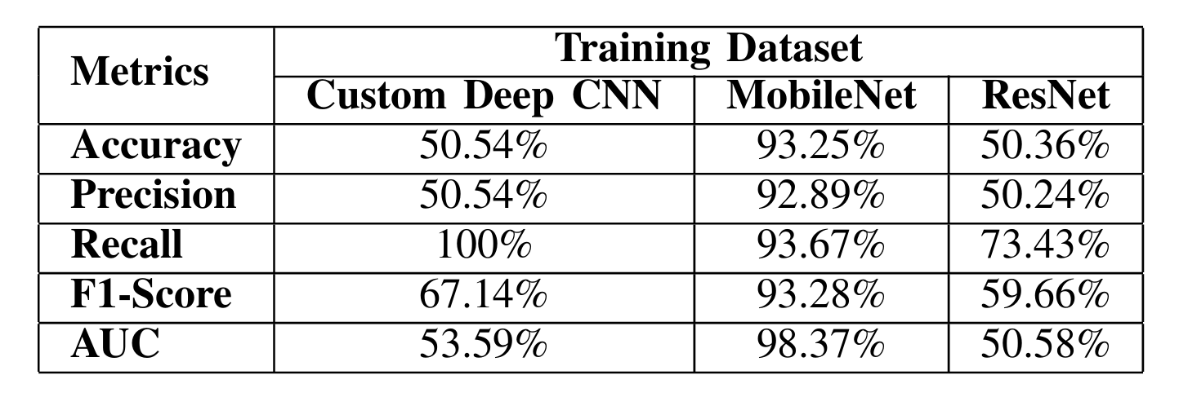
COMPARISON OF PERFORMANCE METRICS FOR DEEP CNN,MOBILENET AND RESNET ON THE TRAINING DATASET

Slide 26
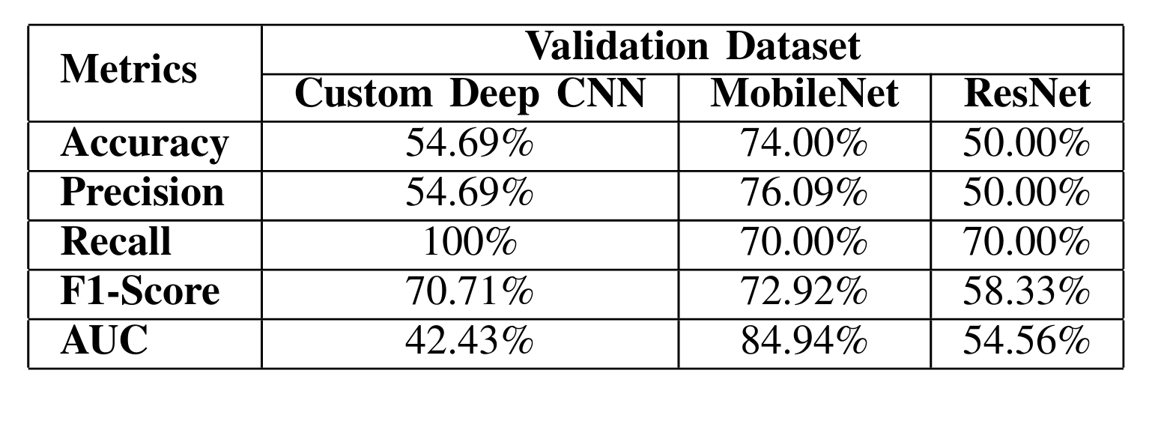
COMPARISON OF PERFORMANCE METRICS FOR DEEP CNN,MOBILENET AND RESNET ON THE VALIDATION DATASET

Slide 27
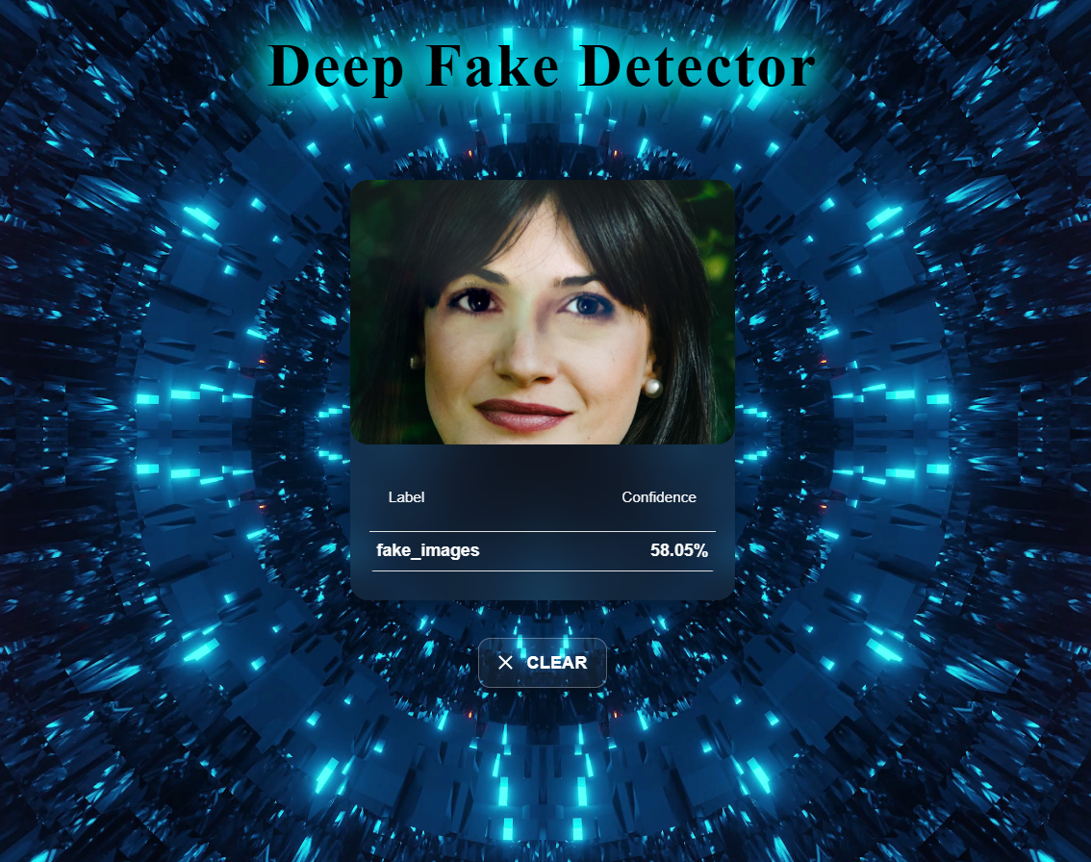
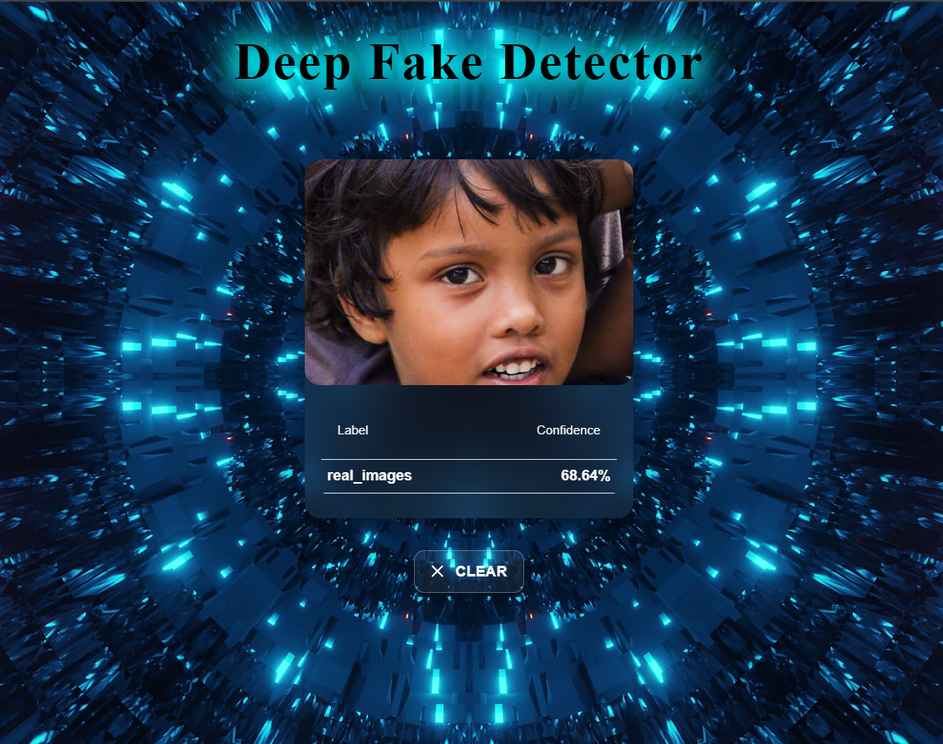
RESULTS
Fig: UI Page Connecting to the Model
Fig: Fake image with a confidence of 58.05%
Fig: Real image with a confidence of 68.64%

Slide 28
LIMITATION
Real-Time Performance: Achieving real-time detection with high accuracy can be challenging, especially for high-resolution images.
Dataset Limitations: The model's performance is heavily reliant on the quality and diversity of the dataset used for training.
Limited Generalization: Models trained on specific datasets might not generalize well to unseen types of deepfakes or face variations.
Processing Speed: Large-scale videos or high-resolution images may take longer to process, reducing the system's speed.

Slide 29
CONCLUSION
The rapid advancement of DeepFake technology poses significant challenges to privacy, security, and public trust, making its detection a critical necessity.
Deep learning models, particularly CNN-based approaches, have proven to be highly effective in identifying DeepFakes by analyzing subtle inconsistencies and anomalies.
Continued research and development in this field are essential to stay ahead of evolving threats and ensure the reliability of digital media.

Slide 30
FUTURE SCOPE
Adaptability to New Techniques: Continuously improve the system to detect emerging and advanced deepfake techniques.
Scalability: Enhance the system’s capability to handle large-scale datasets for broader, real-world applications.
Multi-Platform Detection: Extend the system’s functionality to identify deepfakes across various platforms, including social media, streaming services, and news outlets.
Real-Time Detection: Develop real-time detection capabilities to provide instant analysis and response to deepfake content.
Cross-Media Analysis: Expand detection beyond images and videos to include audio and text-based deepfakes for comprehensive protection.

Slide 31
REFERENCES
H. Tolosana, R. Vera-Rodriguez, J. Fierrez, and J. Ortega-Garcia, "DeepFakes and Beyond: A Survey of Face Manipulation and Fake Detection," Information Fusion, vol. 64, pp. 131-148, Dec. 2020, doi: 10.1016/j.inffus.2020.06.014.
Y. Li, X. Yang, P. Sun, H. Qi, and S. Lyu, "Celeb-DF: A Large-Scale Challenging Dataset for DeepFake Forensics," Proceedings of the IEEE/CVF Conference on Computer Vision and Pattern Recognition (CVPR), pp. 3207-3216, June 2020, doi: 10.1109/CVPR42600.2020.00326.
Z. Guo, H. Wang, X. Peng, and J. Yang, "DeepFake Detection Using Convolutional Neural Networks," Pattern Recognition Letters, vol. 140, pp. 85-91, Nov. 2020, doi: 10.1016/j.patrec.2020.09.006.
M. Mirsky and W. Lee, "The Creation and Detection of DeepFakes: A Survey," ACM Computing Surveys, vol. 54, no. 1, pp. 1-41, Jan. 2021, doi: 10.1145/3425780.
F. Matern, C. Riess, and M. Stamminger, "Exploiting Visual Artifacts to Expose DeepFakes and Face Manipulations," Proceedings of the IEEE Winter Conference on Applications of Computer Vision (WACV), pp. 83-92, Jan. 2019, doi: 10.1109/WACV.2019.00012.
S. Agarwal, H. Farid, O. Fried, M. McDuff, and M. K. Johnson, "Detecting DeepFake Videos from Appearance and Behavior," Proceedings of the IEEE International Conference on Computer Vision (ICCV), pp. 9065-9074, Oct. 2019, doi: 10.1109/ICCV.2019.00916.

Slide 32
THANK YOU

